Slide 1
HSBC Pepper (AI) – Oct 24
Agenda
C.4 Case Study
Introduction / Video
Read CBC Article / Answer Questions
Schedule: Today & Tomorrow
Programming Assignment #1
Be prepared to demo your program
Login to Repl / load your program
Upcoming
TOMORROW: Complete Case Study C.4

Slide 2
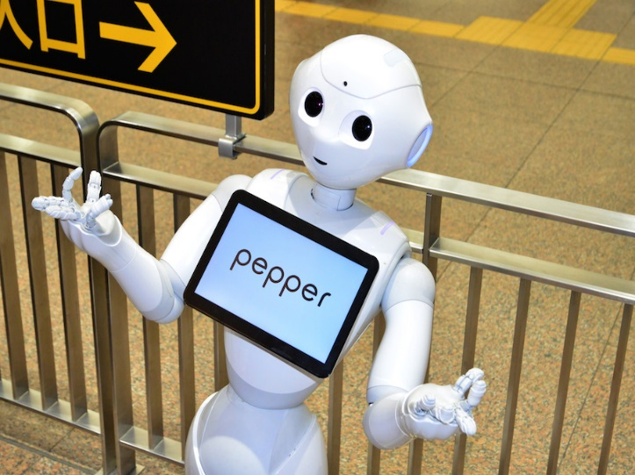
HSBC Pepper
AI – Artificial Intelligence
Not Just Robots
AI Takes Many Forms
AI Has Arrived!
AI Is Greatly Affecting Society TODAY
AI Will Affect YOUR Job Market TOMORROW

Slide 3
A.3 Brochure & Previous Work
Mrs. Manson @ Lunch (Starting Monday)
Sahil
Kunwar
Rajdeep
Devan
Apira
Yashmeen
Aiden
Jaskarandeep
Amadeous
Requirement:
Finish Student Questions
Finish Brochure
All submitted to GitHub

